Slide 1
Apologetics and the Medical Literature on SOGI Sexual Orientation, Gender Identity, and Children Presentation by Paul Dirks Twitter: @pauldirks Read over 700 peer-reviewed research articles on sex and gender Pastor, Father of five. I love and appreciate LGBT persons I have personally read every study I cite in the presentation.
Notes:
Mention also for women.

Slide 2
What is the Christian’s relationship to empirical truth?
Primacy given to special revelation (Scripture)
All truth is Christ’s truth
Empirical data and observations can strengthen conviction and be helpful apologetically
Notes:
That verse doesn’t end. It goes on, hopefully to talk about God’s sovereignty, and his power to do away with evil.
There are many dangerous ideas and even perverse ideas which are presented in our world and in our schools about sexuality and gender. But at the root of these things is a failure not only to obey God and His good design for mankind, but a destruction of the categories of male and female in relationship to marriage and to one another.
We’re consider three errors being taught in society with a focus on young people.

Slide 3
SOGI | Acronym standing for Sexual Orientation (homosexuality) and Gender Identity (transgender)
Sexual Orientation | The kind of person you are sexually attracted to: gay (male to males), lesbian (female to females), bisexual (either male or female attracted to both males or females).
Gender Identity | The belief that your “true” or “inner” gender may not match your biological sex. Almost synonymous with “transgenderism”.
Transgender | Adjective for a person who identifies as a different “gender” than their (biological) sex

Slide 4
Gender Dysphoria | Clinical diagnosis of significant distress for incongruity between sex and gender identity
Transsexual | Older term still used in some medical literature to denote those who have medically transitioned with hormones and/or surgeries.
Transvestite | Those who cross-dress, mostly men, usually for sexual arousal. Included in the broader category of “transgender”.
Intersex | Sexual disorders of chromosomes, genitalia, or reproductive organs that aren’t correctly sexually dimorphic.

Slide 5
Homosexuality: Nature or Nurture?
There are almost certainly pre-birth factors (whether genetic, epigenetic, or more likely, hormonal). The heritability of homosexuality is, however, no more than for dozens of other behaviors, including smoking and divorce.
Notes:
Those with gender dysphoria as a clinical diagnosis is EXTREMELY small. Below 0.1%.

Slide 6
Homosexuality: Nature or Nurture?
Over the last 5 years the academic consensus is that homosexuality is not immutable. Studies by Diamond, Ott, Katz-Wise and others show enormous rates of fluidity in non-heterosexuality. (Diamond, 2016 Scrutinizing Immutability)
“I feel that as a community, the queers have to stop saying, ‘Please help us. We were born this way and we can’t change’ as an argument for legal standing. I don’t think we need that argument and that argument is going to bite us in the ass. Now we know that there is enough data out there that the other side is aware as much as we are aware of it.” (Diamond, 2013)
Notes:
““I feel that as a community, the queers have to stop saying, “Please help us. We were born this way and we can’t change” as an argument for legal standing. I don’t think we need that argument and that argument is going to bite us in the ass. Now we know that there is enough data out there that the other side is aware as much as we are aware of it.” (Diamond, 2013)

Slide 7
Homosexuality: Nature or Nurture?
Savin-Williams (2007): In a large, longitudinal, population-based US study, found that 83% of same-sex behaved adolescents became exclusively heterosexually behaved in 6 years.
“The instability of same-sex romantic attraction and behavior… presents a dilemma for sex researchers who portray nonheterosexuality as a stable trait of individuals” (emphasis mine)

Slide 8
Homosexuality and Associated Risks
Same-Sex Behaviour and Identity Associations in Adolescents:
Suicidality (Zhao, 2010; King, 2008)
Teen pregnancy (Saewyc, 2014)
Childhood sexual trauma→ future SSB (Wilson, 2010)
Childhood separation anxiety (Patterson, 2017)
Number of sexual partners (Garafalo, 1998)
Early onset of sexual behaviour (Garafalo, 1998)
Drug use (Garafalo, 1998)
Criminality (Beaver, 2016)
Notes:
Most informed people will recognize the associated risks with SSB/SSI.
Will these harms reduce if stigma/victimization lessens?
Data from Netherlands and San Francisco show that suicidality remains multiple times higher among LGBT.

Slide 9
Homosexuality and Associated Risks
Minority-stress theory doesn’t completely explain these disparities:
Reductions in risk levels often around 20-30%
Studies from very progressive places keep reporting highly elevated risks
“Adverse childhood effects” like household mental illness, incarcerated household member, sexual abuse higher among non-heterosexuals (Andersen, 2013)
Notes:
Sometimes the gap doesn’t narrow at all, as in Goodenow 2016 where they did a longitudinal study over 12 years and the LGBT populatoin

Slide 10
Schools-GSA
Goodenow, 2016 (Massachusetts)
LGBT youth more than doubled in 12 years, from 3% to 6.3%, especially girls (3.7% to 8.2%).
Almost all groups reported better outcomes, however "Equally, if not more, troubling is our finding that, despite some widespread improvements in the social situation of sexual minorities and despite the specific reductions in school violence observed here, sexual orientation disparities remain largely unchanged."
In fact, for the largest group (bisexual females) they got worse relative to heterosexual females.
Notes:
First place to have a GSA and studied
One of the only places we have significant studies on LGBT stuff in schools. Very pro-LGBT state.
1999-2013 Massachusetts From 8 biennial surveys: 4 waves. Bullying data only for W2-4. Grades 9-12
Bisexual females comprised more than half of the total LGB group in the last wave: 56%
The at-risk group doubled and the largest group in this group got worse relative to heterosexuals.
This is somewhat preliminary. It is consistent with what I have seen but I don’t know yet whether there are studies which would show contrary findings.
more than any other place. Longitudinal over 12 years- 6 different sampling periods

Slide 11
What percentage of the population is Transgender?
The answer is dependent on how one asks the question. “Are you transgender” is answered in the affirmative by 0.6% of the population in Flores, 2016, for The Williams Institute.
Rates of adolescents who claim to be neither strictly male or female can be much higher, as high as 3% in some places.
Notes:
MOVE on to Transgender.
Those with gender dysphoria as a clinical diagnosis is EXTREMELY small. Below 0.1%.

Slide 12
The Transition Conveyer Belt
Social Transition
Greatly reduces desistence (Steensma, 2013).
Puberty Suppression
Lupron, made by Abbvie used off-label.
Cross-Sex Hormones
Some changes permanent. Sterilization.
Puberty affects brain and bone development
Reduces desistence of GD even further.
No long-term data on effects.
Permanent removal of healthy body parts
Difficult to detransition (Steensma, 2011)
Socially contagious
Name, dress, pronouns of new gender
Top and Bottom Surgery
3+
9+
12+
13+
Notes:
Those who suppress puberty or take CSH very rarely desist. In one study, 0%, in another it was one of the cohort.
The Tavistock’s own published study on their Early Intervention trial shows that of 44 children given puberty blockers, 43 (98%) progressed to cross-sex hormones.
Endocrinologist, Dr. Michael Laidlaw, discovered via a Freedom of Information Act request that the minimum age for administration of cross-sex hormones had been lowered from 13 to 8 in a large five-year study being conducted at the Children’s Hospital Los Angeles. https://newspunch.com/cross-sex-hormones-can-now-be-given-to-us-children-as-young-as-eight/
Olson, 2017 has children as young as 12 on hormones

Slide 13
Three Reasons the Transgender Trend and Narrative is Dangerous and Not Evidence-Based
Gender Dysphoria Goes Away (“desistence”)
Long-Term Outcomes are Very Poor
Gender Dysphoria and Non-Conformity are Socially Contagious

Slide 14
Desistence of Gender Dysphoria
Vast majority of gender-disordered children will desist in their dysphoria after adolescence.
Steensma, 2011, Desisting and Persisting,
“Although the persistence rates differed between the various studies (2% to 27%), the results unequivocally showed that the gender dysphoria remitted after puberty in the vast majority of children.”

Slide 15
Desistence of Gender Dysphoria
One of the best studies is by Canadian doctor Devita Singh, 2012.*
“Of the 88 participants [all natal males] who met the full diagnostic criteria for GID in childhood, 12 (13.6%) were gender dysphoric at follow-up and the remaining 76 (86.4%) were no longer gender dysphoric.”
*this study is unpublished, but is cited by Steensma in 2013.

Slide 16
Desistence of Gender Dysphoria
In Steensma 2013, the only study which had social transition as a variable, 74% of those who had not socially transitioned desisted in their gender dysphoria. Only 35% of those who had any social transition desisted.
For my full video overview of the studies on desistence of GD: https://youtu.be/2N2kbfNyXw8

Slide 17
Poor Outcomes for Transition
Due to the newness of studies on gender dysphoria and transition, and the low number of patients, studies on outcomes are still in their infancy.
Although some studies show good outcomes for transitioned individuals, generally, longer-term studies (> 10 yrs.) show vastly worse outcomes than short-term ones (< 10 yrs.) (eg. Simonsen 2016, Dhejne 2012, Kuhn 2009, Asscheman 2011)
Notes:
Marshall goes on to say: When researching the factors that contribute to vulnerability of suicidality in the trans population, the authors also found that mental health problems and experiences of harassment, discrimination, violence and rejection may increase the risk in this population.”

Slide 18
Poor Outcomes for Transition
An enormous problem for the long-term outcome studies is very high “lost to follow-up” rates (30-50%).
Three long-term studies have dealt with this problem by using national registries in their countries to track vital statistics on entire groups.
Notes:
Marshall goes on to say: When researching the factors that contribute to vulnerability of suicidality in the trans population, the authors also found that mental health problems and experiences of harassment, discrimination, violence and rejection may increase the risk in this population.”

Slide 19
Poor Outcomes for Transition: Asscheman, 2011 (Netherlands)
1331 post-cross-sex-hormones transsexuals
Average follow-up was 18.4 years
“The increased mortality risk in MtF in our cohort was characterized by a high SMR of suicide (of 5.70), AIDS (of 30.2), and illicit drug-related deaths (of 13.2).”
Notes:
Marshall goes on to say: When researching the factors that contribute to vulnerability of suicidality in the trans population, the authors also found that mental health problems and experiences of harassment, discrimination, violence and rejection may increase the risk in this population.”

Slide 20
Poor Outcomes for Transition: Dhejne, 2011 (Sweden)
324 post-surgery transsexuals
Average follow-up was 11.4 and 10.4 years, depending on variable
Comparison to controls, but not prior histories
Death by suicide was 19 times higher than in controls. Psychiatric hospitalization (after adjusting for prior morbidity) was 2.8 times higher. Suicide attempt was 7.6 times higher.
Notes:
Marshall goes on to say: When researching the factors that contribute to vulnerability of suicidality in the trans population, the authors also found that mental health problems and experiences of harassment, discrimination, violence and rejection may increase the risk in this population.”

Slide 21
Poor Outcomes for Transition: Simonsen, 2016 (Denmark)
104 post-surgery transsexuals (98% of total)
Average follow-up was 16.4 for MtF and 10.2 for FtM
“we found that 28% of the study group had been diagnosed with psychiatric morbidity pre-SRS and 22% post-SRS. No significant differences were found between the number of MtF and FtM individuals suffering from psychiatric morbidity pre- and post-SRS”
Notes:
Marshall goes on to say: When researching the factors that contribute to vulnerability of suicidality in the trans population, the authors also found that mental health problems and experiences of harassment, discrimination, violence and rejection may increase the risk in this population.”

Slide 22
Poor Outcomes for Transition: Simonsen, 2016 (Denmark)
104 post-surgery transsexuals (98% of total)
Average follow-up was 16.4 for MtF and 10.2 for FtM
“almost 10% of the study population died at a mean age less than 60 years where the life-expectancy of assigned females and males in Denmark is 81.9 years, and 78.0 respectively. Although limited by the number of individuals included in this study, the results may provide some indication that SRS individuals are at increased risk of mortality post-SRS”
Notes:
Including 2 suicides

Slide 23
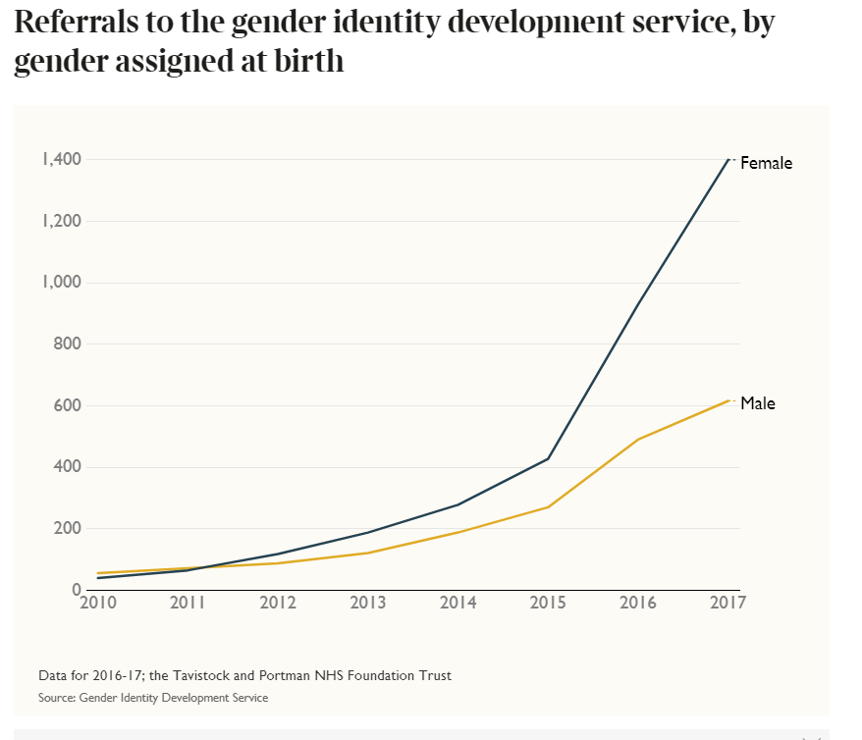
Vast Increases in the Number of Gender Dysphoric Children and Adolescents Twenty-fold increase in 8 years in the UK
Notes:
20 fold increase in 9 years.

Slide 24
Vast Increases in the Number of Gender Dysphoric Children/Adolescents
Social contagions, including suicide, obesity, sexual behaviors, have been well documented by Christakis (Connected, 2009)
Mental disorders have recently been shown to be socially contagious (JY Wang, 2017).

Slide 25
Vast Increases in the Number of Gender Dysphoric Children/Adolescents
Lisa Littman, 2017, coined the term Rapid-Onset Gender Dysphoria (ROGD) which is now being used by sex researchers like Blanchard and Bailey, as well as in the national media by writers like Barbara Kay (National Post) and sex researcher Debra Soh (Globe and Mail)

Slide 26
Vast Increases in the Number of Gender Dysphoric Children/Adolescents
Ratio is skewing significantly towards girls.
Finnish study (Kaltiala-Heino, 2015):
“Adolescents are more suggestible and submit more readily to group pressure to gain acceptance…. During puberty and adolescent development there may be some overlap between normative testing of sexuality and gender roles in the one end, and gender dysphoria as a disorder in the other end of the spectrum. This would implicate that GD in adults and in adolescence may not be the same issue in general.”

Slide 27
“Born this way”?
Singh, 2012 (p174-175) and Steensma, 2011 found that higher social class was associated with higher desistence rates of gender dysphoric adolescents.
Shumer, 2017 Overrepresentation of Adopted Adolescents. Gender dysphoric patients were 4x as likely to be adopted than most adolescents. (see also Zucker and Bradley, 1998)

Slide 28
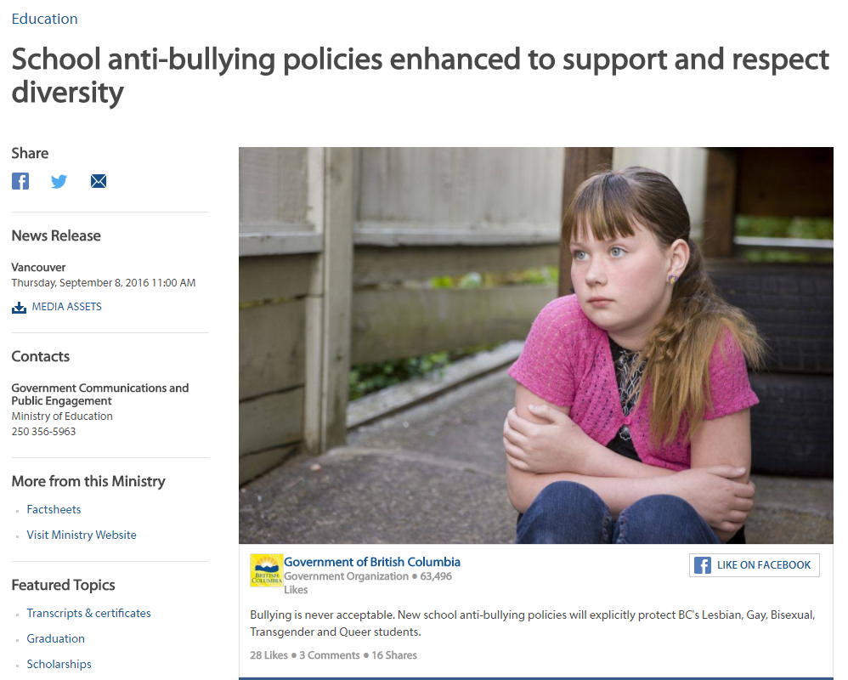

Slide 30
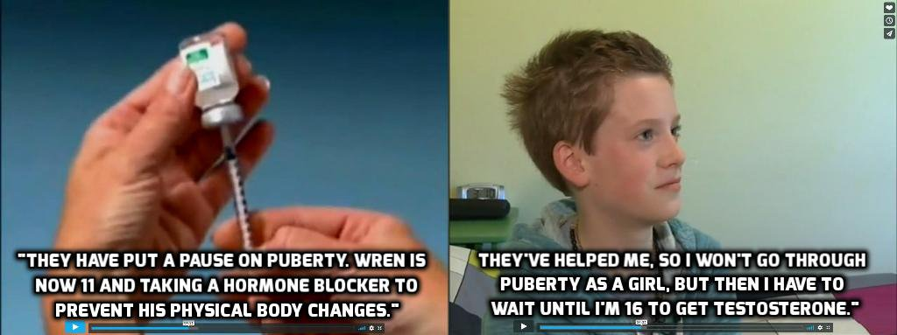
SOGI 123 Resource Video
Celebrating the medicalizing of pre-teens

Slide 31
Notes:
Need to touch on women’s privacy. Parents rights: your Lucy could be identifying as Luke at school, and the school will not tell you. Freedom of speech.

