Slide 1
Valleyview Bible Church
October 2022
A Deeper Theology of
Sex & Gender
Paul Dirks
Lead Pastor, New West Community Church
Appeared before Senate Committee on Bill C-16. Read over 700 peer-reviewed medical articles on sex and gender. Trained churches, pastors, doctors, counsellors on sex and gender research.

Slide 2
THEOLOGY OF GENDER AND SEXUALITY
God in relationship to gender and sexuality
Human purposes of gender and sexuality
Are gender differences good?

Slide 3
Theology of Gender and Sexuality
The most fundamental distinction about the Christian God is that He is One-in-Three.
Each Divine Person is equal in essence and attributes, but there is diversity in roles and expression of the divine attributes.
Who is God?
Notes:
Then God said, “Let us make man in our image, after our likeness. And let them have dominion over the fish of the sea and over the birds of the heavens and over the livestock and over all the earth and over every creeping thing that creeps on the earth.” So God created man in his own image, in the image of God he created him; male and female he created them.” (Ge 1:26–27)
Example. If I said which person of the Trinity is wisdom most clearly seen- Father. Humility- Son. Heresy, however, if you said the Father is wiser than the Son.

Slide 4
Theology of Gender and Sexuality
The most fundamental distinction of the Divine Persons is the nature of the derivation of their Person.
The Son’s Person is eternally derived from the Father (eternal generation).
Who is God?
Notes:
*Some would argue the only distinction

Slide 5
Herman Bavinck:
God’s fecundity is a beautiful theme, one that frequently recurs in the church fathers. God is no abstract, fixed, monadic, solitary substance, but a plenitude of life. It is his nature to be generative and fruitful It is capable of expansion, unfolding, and communication. Those who deny this fecund productivity fail to take
seriously the fact that God is an
infinite fullness of blessed life.
Theology of Gender and Sexuality
Who is God?
Notes:
God eternally begets nothing less than God.
It is natural then that this kind of God would create. Creation isn’t necessary. But it would seem inevitable considering the kind of abundance and fruitfulness that is in God.
Image of God in man: equality/diversity, but also there is a fecundity, generative potential within mankind. Linger here and talk about the angels. Hebrews. What is different about the angels and man. Angels are messengers, not made in God’s image. Though more powerful and glorious in appearance, there is a breadth, you might say a potential to man that in many ways surpasses the angels. Breadth of human relationships, family→ society, procreate, build for ourselves little kingdoms and clans that unless Christ returns to arrest history and usher in the end, is capable of expansion forevermore. Remarkable.

Slide 6
God created man(kind) to image God (Gen 1:27a) in both our GENDER and our sexuality.
Equality: Both man and woman created in the image of God (v27b). Both are worthy of value and honor as image-bearers (human persons).
Diversity: Man and woman both needed to together image God
(v28) Both are worthy of value and honor as gendered persons.
Theology of Gender and Sexuality
Who is Man(kind)?
Notes:
Becomes explicit in chapter 2.
Then God said, “Let us make man in our image, after our likeness. And let them have dominion over the fish of the sea and over the birds of the heavens and over the livestock and over all the earth and over every creeping thing that creeps on the earth.” So God created man in his own image, in the image of God he created him; male and female he created them.” (Ge 1:26–27)

Slide 7
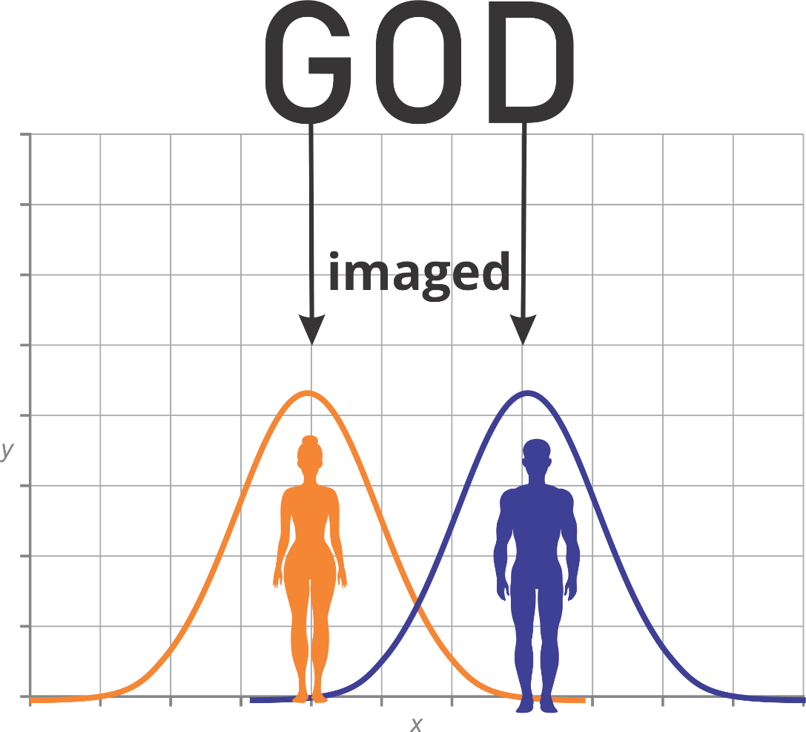
Characteristics of God are emphasized (not exclusively) in gender.
Theology of Gender and Sexuality
Who is Man(kind)?
Notes:
Characteristics, a few are explicit in the text of Genesis 1-3, but much of it is inferred. Man is specifically given a work and job in tending the garden, and the woman is stated to be his helper in that work (Gen 2). The headship and authority of Adam is seen in the fact that even though Eve is the first to sin, it is Adam who is responsible, and through whom sin spreads to the entire race. Most clearly seen in the curses of Gen 3– curses on Eve relate to family and relations to her husband and to her children. Man it is related to his work– to the outside world and this work of dominion. So there are emphases and assymetries, although there are also symmetries.

Slide 8
What is good about being a man?
What is good about being a woman?
Theology of Gender and Sexuality
Who is Man(kind)?
Notes:
This is an uncomfortable question, but a highly important one. Before delving into what I think a good answer is to this, bare fact—if we as a church can’t answer that, and communicate that to our children, we shouldn’t be surprised if they are confused or even want to transition. Before we perhaps stumblingly try to answer it, we have to start with the fact that we MUST answer it.
I will often do a longer version of this activity I call the diversity game (or could actually do it)
The reson it is hard to answer this is because there are only two. So it is an exclusive thing. If you say that one of the good things about being man is being strong,k you are inherently saying that women, as a generalization are weaker. And we despise generalizations in our culture, and especially if those generalizations have an inherently negative corollary.

Slide 9
These emphases are not absolute but constitute wonderful generalities.
Men have 80% greater upper-body strength, and 50% greater lower-body strength than women.
Women, across an enormous breadth of cultures and countries, are far more open to emotion than men in the personality studies.
Theology of Gender and Sexuality
Who is Man(kind)?
Notes:
Vs. social constructionism, changes in the brains of women due to hormones released during childbirth that make for more emotional openness and bonding—it’s physiological.
Why are these generalities “wonderful”:
Mutual need in society
Mutual need in marriage
Humility in relationship to God
Picture of Christ and the Church

Slide 10
God created man(kind) to image God (Gen 1:27a) in both our gender and our sexuality.
Neither gender nor sexuality can be read back onto God.
We ought not talk about the “masculine” or “feminine” characteristics of God.
Neither is God sexual. However our sexuality is reflective of many aspects of who God is.
Theology of Gender and Sexuality
Who is Man(kind)?
Notes:
Qualifications: Note, however, male pronouns. Normativeness or primacy to man. There is a particularity or preeminence to women. She is said to be the glory of man. The way in which we see this

Slide 11
Trinitarian Theology Reflected in Gender and Sexuality
In the eternal generation of the Son, the Father is giver and the Son is receiver
In the eternal purpose (covenant) the Father desires to give a reward, a people, and a dominion to His Son, which requires a redemption
Theology of Gender and Sexuality
Who is Man(kind)?
Notes:
Ad Intro→Eternal Purpose/Convenant→Creation – through him for him (Col 1:16) → Redemption given a name above every name because he humbled himself

Slide 12
Trinitarian Theology Reflected in Gender and Sexuality
By the means of the application of Christ’s work by the Spirit, who fulfills all things, Christ is promoted within creation/redemption.
The Father initiates/gives, the Son receives and is blessed
Theology of Gender and Sexuality
Who is Man(kind)?
Notes:
Ad Intro→Eternal Purpose/Convenant→Creation – through him for him (Col 1:16) → Redemption given a name above every name because he humbled himself
Trinitarian shape is reflected in marriage and sexual relations. You could say it is reflected in gender, but more clearly when that gender is manifested in a dyadic relationship of marriage

Slide 13
God’s Characteristics Emphasized in Men:
Reflecting the normativity and initiation of the Father:
Provide
Protect
Promote
Theology of Gender and Sexuality
Who is Man(kind)?

Slide 14
God’s Characteristics Emphasized in Men:
Reflecting the preeminence and recipiency of the Son:
Resplendent (Glorious)
Responsive
Restful (Comfort)
Theology of Gender and Sexuality
Who is Man(kind)?
Notes:
is so disconcerting that these kinds of generalization are often seen as negative for women. They are positive characteristics that any woman would look for in a mate.
Resplendent: reflect the wonder and glory and beauty of God. There is a reason why the glory or beauty of women are exploited and sexualized in culture. Beauty is powerful. One of the most important and powerful things you can say to a young girl or woman is “you are beautiful”. 1 Cor 11 between authority and glory htat echoes out from the Father-Son relationship int eh Trienity to the husband wife relationship
Responsive: far quicker to respond in their spirits to needs. Women tend to have far more open spirits than men.
Restful: God rested. Self-satisfaction in God. Extravagance. Being not doing. Place of rest for her family.

Slide 15
God created man(kind) to image God (Gen 1:27a) in both our gender and our SEXUALITY.
We are to image ourselves in others the way the Son images the Father (Col 1:15) and we image God.
Procreation was, and remains, primarily a disciple-making endeavour for the spread of God’s kingdom (Gen 1:28, Mal 2:15, Mat 28:18).
Theology of Gender and Sexuality
Who is Man(kind)?
Notes:
Already mentioned that in eternal generation we see an aspect of the fecundity of God. Interestingly, as a further piece of Trinitarian theology, many of the Early Church Fathers and some of the Medievals as well, saw in the triad of Adam-Eve-Seth or Adam-Eve-Cain a reflection of the Trinity. In this triad, if it is not already obvious, the HS is reflected in procreation. And I think that is fitting. I do think the analogy works, though not without limitations, as all analogies do. Without going into the theology,

Slide 16
SOGI actually undermines diversity
Gay “marriage” has completely erased marriage definitionally
Singleness, although elevated in the NT, is not normative
Theology of Gender and Sexuality
Implications
Notes:
Procreation definition of marriage
Singleness – don’t want to harm anyone, (story of how matchmaking never works for me) , in raising our children we need to raise men to be fathers full stop. That’s normative. Raise girls to be mothers. That’s normative

