Slide 1

Our SOGI Culture and How We Got Here
Paul Dirks
Published at Public Discourse. Author of Is There Anything Good About Hell?
Co-founder of COMPASS Schools and New Antioch Institute
Pastor. Father of five.
Notes:
Mention also for women.

Slide 2
The Pagan Exchange
For although they knew God, they did not honor him as God or give thanks to him, but they became futile in their thinking, and their foolish hearts were darkened. Claiming to be wise, they became fools, and exchanged the glory of the immortal God for images resembling mortal man and birds and animals and creeping things. Therefore God gave them up in the lusts of their hearts to impurity, to the dishonoring of their bodies among themselves, because they exchanged the truth about God for a lie and worshiped and served the creature rather than the Creator, who is blessed forever! Amen. (Ro 1:21–25)
Notes:
Mention also for women.

Slide 3
Snapshots of our Sex-Confused World
Ontario shop-teacher wearing enormous prosthetic breasts to school
BCTF lesson plan normalizing masturbation and instructing children to draw genitalia
SOGI123 principles: males in female spaces, undermine parental rights with “confidentiality”
Fully-intact, violent male rapists in women’s prisons
Notes:
Mention also for women.

Slide 4
Snapshots of our Sex-Confused World
BC infants act means minors can medically transition without parental approval
Public-schooled children taken off-site to drag shows, or personal houses without parental permission
Drag-queen story hours or even drag-shows for children
Pornographic and even child-pornographic books in schools
Notes:
Mention also for women.

Slide 5
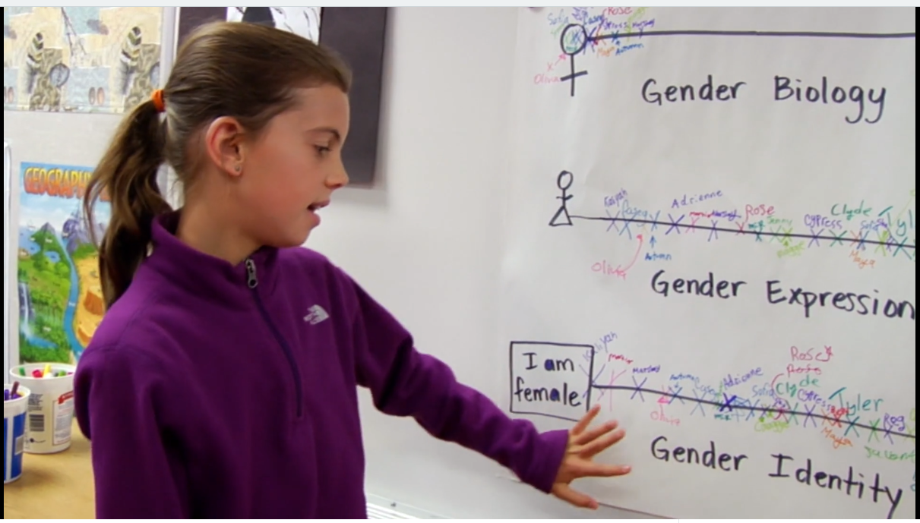

Slide 6
How Did We Get Here?
Religious movement centered on a self without reference to God. Fulfillment of enlightenment and post-modern projects.
Marxism/Communism was rabidly anti-family
  Communist Manifesto (1848): “abolition of the family”
  Engels (1884) hoped to unleash “unconstrained sexual intercourse” to free women.
Notes:
Conflation of philosophical movement, scientific or pseudo-scientific movements, social movements, and political movements.

Slide 7
How Did We Get Here?
Contraception:
  Margaret Sanger: racist, sexual libertine
  Lambeth 1930 permitted contraceptive use
Freud (1930): sexual love afforded man the strongest experiences of satisfaction… general erotism the central point of his life.
Freud’s philosophy and Kinsey’s (1894-1956) research normalized sexual immorality and child sexuality
Notes:
Carl Trueman also chronicles the turn to the inward psychological life in poets and writers William Wordsworth, Percy Bysshe Shelly and William Blake.
Freud and child sexuality in connection with masturbation see Trueman p208-209

Slide 8
How Did We Get Here?
Postmodernists, Foucault (1926-84) and Derrida (1930-2004) undermined objective truth and created the philosophical basis for a victim culture
Feminism and the sexual revolution created a fertile ground for the LGBT movement
Notes:
Feminism defines womanhood as a struggle, rather than anything inherently good. Buck against their very gender

Slide 9
How Did We Get Here?
Transgender ideology is the penultimate movement away from the image of God and a neo-gnostic religion
Pedophilia and transhumanism are around the corner. Foundations are already laid
Notes:
Conflation of philosophical movement, scientific or pseudo-scientific movements, social movements, and political movements.

Slide 10
The Hope of the Gospel of Christ
Christ is Lord—do we believe and life this?
Times of darkness reveal the light, growth of faithful churches is almost certain
Notes:
Conflation of philosophical movement, scientific or pseudo-scientific movements, social movements, and political movements.

